Slide 1
Chapter 9
Six-Sigma Quality Management
Notes:
2

Slide 2
Outline
Quality and Total Quality Management (TQM)
Six-sigma (6σ)
Statistical Process Control
Notes:
2

Slide 3
Quality
A term used by customers to describe their general satisfaction with a service or product.
  Performance: primary product or service characteristics
  Features: added touches, bells and whistles, secondary characteristics
  Reliability/durability: consistency of performance over time
  Serviceability: ease of repair and access other services
  Aesthetics: sensory characteristics
  Perceived quality: past performance and reputation

Slide 4
Quality (Cont.)
Design quality:
  inherent value of the product in the marketplace
Conformance quality:
  degree to which the product or service design specifications are met
Two fundamental operational goals:
  Careful design of the product or service
  Ensuring that the organization’s systems can consistently produce the design
Notes:
7

Slide 5
Total Quality Management (TQM)
Managing the entire organization so that it excels on all dimensions of products and services that are important to the customers
A philosophy that stresses three principles for achieving high levels of process performance and quality:
    Customer satisfaction
    Employee involvement
    Continuous improvement in performance
Notes:
3

Slide 6
Costs of Quality
Management often needs hard numbers
Joseph Juran: Quality Control Handbook
“All of the costs attributable to the production of quality that is not 100 percent perfect”
Four Types
Appraisal costs
  Inspection and testing
Prevention costs
  Prevent defects
Internal failure costs
  Costs for defects incurred within the system
External failure costs
  Costs for defects that pass through the system

Slide 7
ISO 9000 and ISO 14000
Series of standards agreed upon by the International Organization for Standardization (ISO)
  Adopted in 1987
  More than 160 countries
  A prerequisite for global competition
ISO 9000 directs you to "document what you do and then do as you documented“
ISO 14000 is a family of standards on environmental management
What ISO standards do for you
Notes:
24

Slide 8
Malcolm Baldridge National Quality Award
Established in 1987 by Department of Commerce
Goal is to help companies review and structure their quality programs
Has requirement that suppliers demonstrate they are measuring and documenting their quality practices
Example: Henry Ford Health System

Slide 9
Outline
Quality and Total Quality Management (TQM)
  Definition of quality and TQM
  Importance of quality and TQM
  Costs of quality
  Quality certifications and national awards
Six-sigma (6σ)
Statistical Process Control
Notes:
2

Slide 10
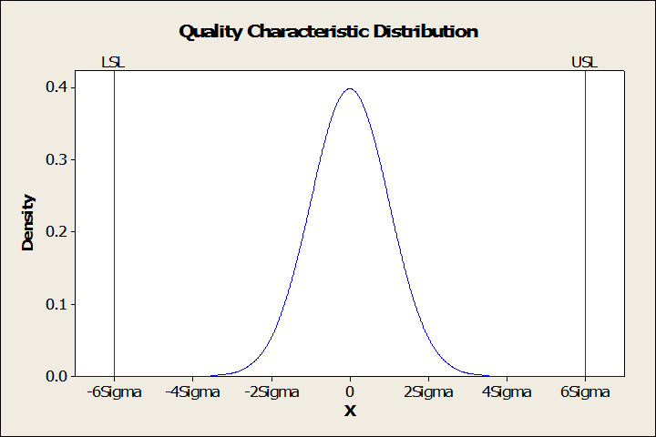
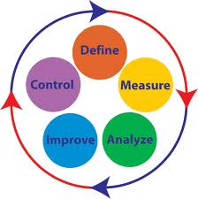
Six Sigma
    The philosophy and methods companies use to eliminate defects
    Six sigma is based on a statistical measure that equates to 3.4 or fewer errors or defects per million opportunities (dpmo).

Slide 11


Six Sigma
Motorola (mid-1980s)
  Improve product and services quality ten times by 1989
  Achieve six-sigma capability by 1992.
  Ultimate goal: zero defects—in everything we do.
  The idea of Six Sigma was “born” at Motorola
General Electric (mid-1990s)
  Six Sigma Interview with Jack Welch
Rapid growth and interests in subsequent years.

Slide 12
Six-Sigma Methodology (DMAIC )
Define: identify excising problems and critical to quality (CTQ) characteristics
Measure: Measure the process
Analysis: Most likely causes of defects
Improve: Remove the causes of defects
Control: Maintain the improvements

Slide 13
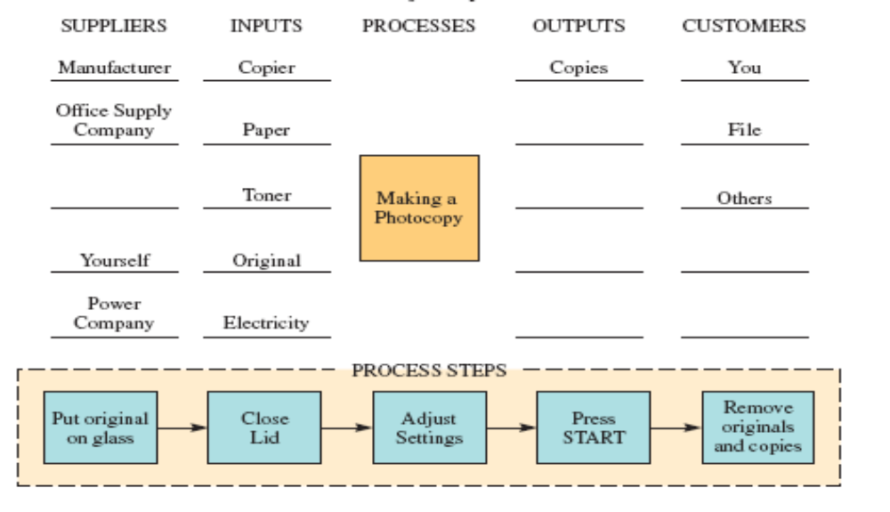
1. Define - Flowchart
A diagram of the sequence of operations

Slide 14
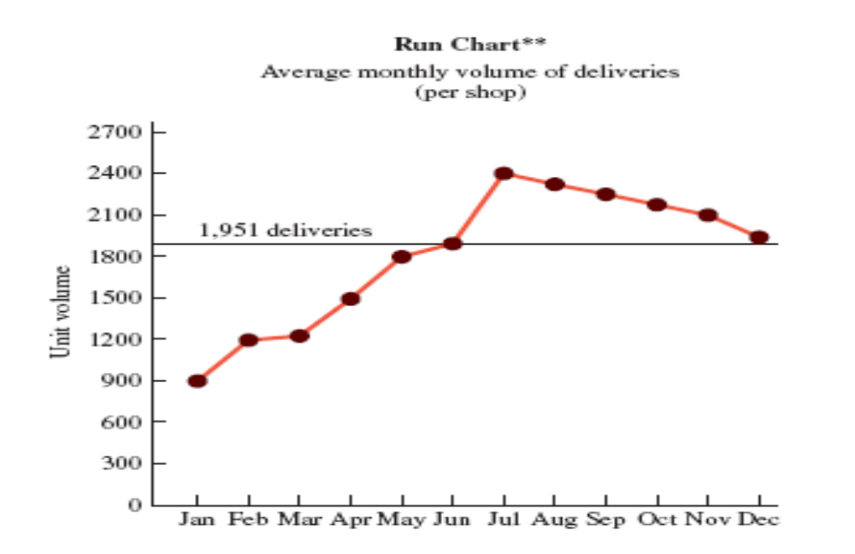
2. Measure - Run Chart
Depict trends in data over time

Slide 15
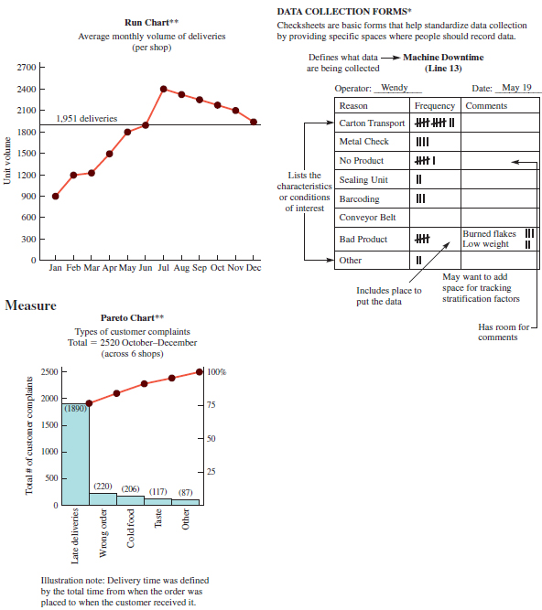
2. Measure - Pareto Chart
help to break down a problem into components

Slide 16
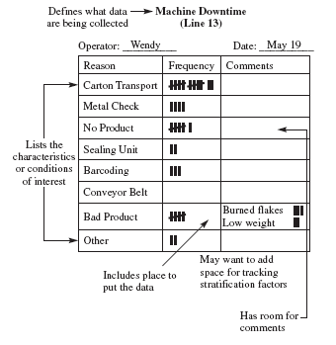
2. Measure - Checksheet
basic form to standardize data collection

Slide 17
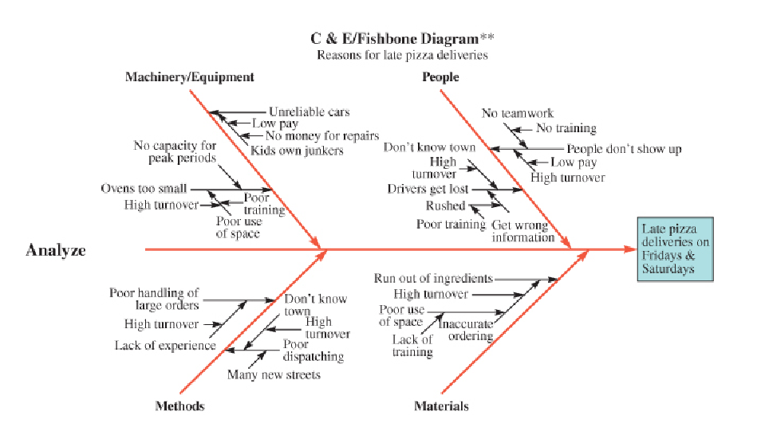
3. Analyze - Cause-and-Effect Diagram
[fishbone diagrams]
Show relationships between causes and problems

Slide 18
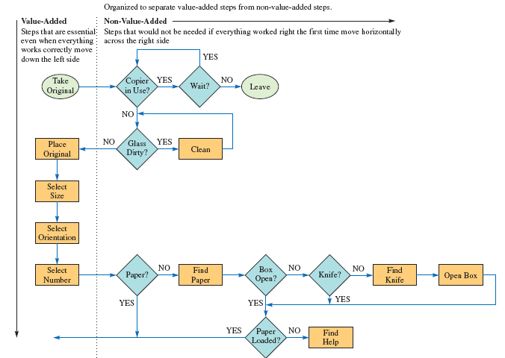
4. Improve - Opportunity Flow Diagram
Separate value-added from non-value-added

Slide 19
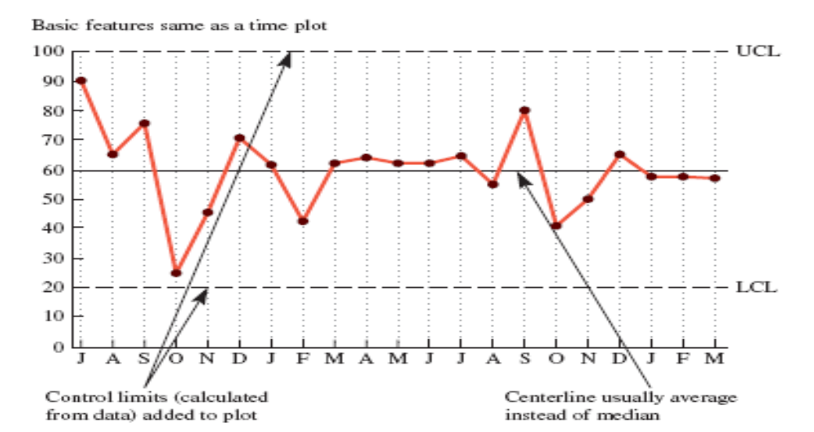
5. Control - Process Control Chart
Assure that processes are in statistical control

Slide 20
Outline
Quality and Total Quality Management (TQM)
  Definition of quality and TQM
  Importance of quality and TQM
  Costs of quality
  Quality certifications and national awards
Six-sigma (6σ)
  Introduction to six-sigma
  Six-sigma methodology (DMAIC)
Statistical Process Control
Notes:
2

Slide 21
Statistical Process Control
Statistical process control
  The application of statistical techniques
  To determine whether a process is delivering what the customer wants.
Sampling plan: A plan that specifies
  Sample size
  Time between successive samples, and
  Other decision rules when taking the action of sampling

Slide 22
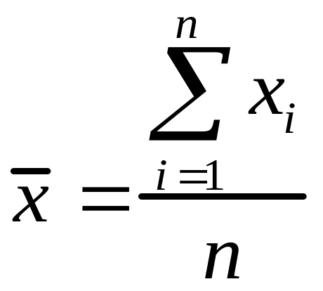
Sampling Distributions
A sample mean is the sum of the observations divided by the total number of observations.
Sample Mean
where
x_{i} = observations of a quality characteristic such as time.
n = total number of observations
x = mean
The distribution of sample means can be approximated by the normal distribution.
Notes:
4

Slide 23
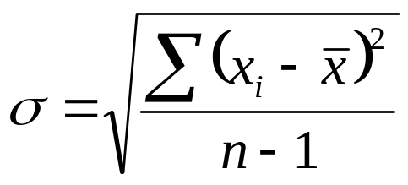
Sample Sigma (Standard deviation)
The standard deviation is the square root of the variance of a distribution.
where
σ = standard deviation of a sample
n = total number of observations
x_{i} = observations of a quality characteristic
x = mean

Slide 24
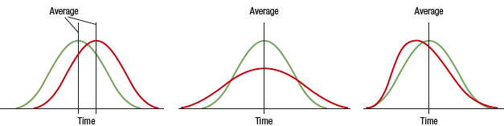
Process Distributions
A process distribution can be characterized by its location, spread, and shape.
Location
Spread
Shape

Slide 25
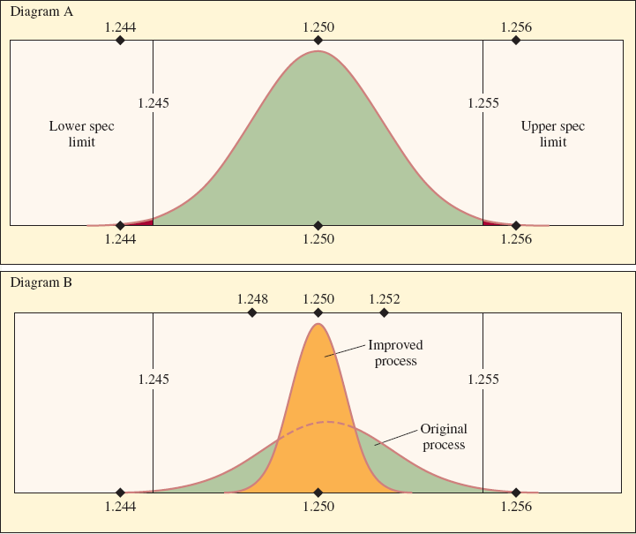
Process Capability
LO 2

Slide 26
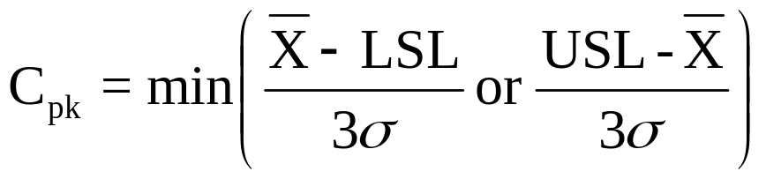
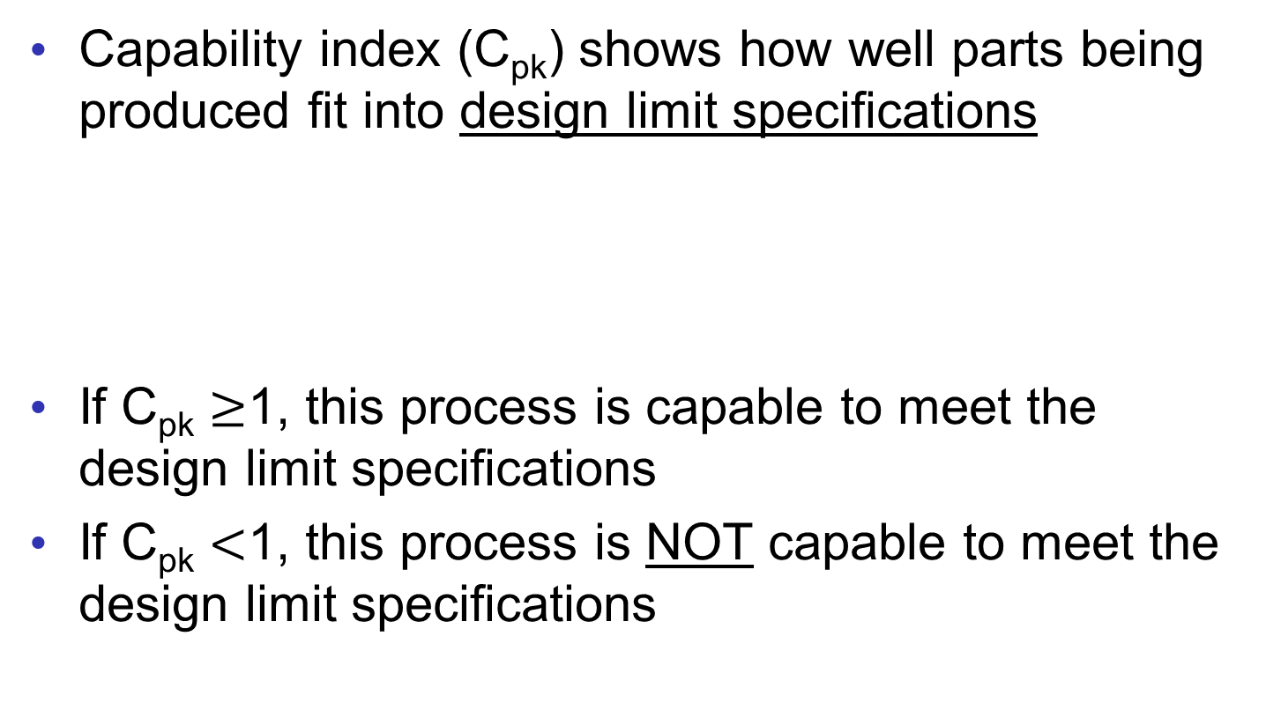
Capability Index (C_{pk})
Capability index (C_{pk}) shows how well parts being produced fit into design limit specifications
If C_{pk} $≥$1, this process is capable to meet the design limit specifications
If C_{pk} $<$1, this process is NOT capable to meet the design limit specifications
Notes:
29

Slide 27
Example of Capability Index
The quality manager is assessing the capability of a process that puts pressurized grease in an aerosol can
Designed specification limits:
  Lower Specification Limit (LSL) = 55 psi
  Upper Specification Limit (USL) = 65 psi
Based on their current process, the sampling results:
  Sample Mean = 61 psi
  Sample sigma (Standard Deviation)= 2 psi
Is this process capable to meet designed specifications [55psi,65 psi] or not?
Notes:
29

Slide 28
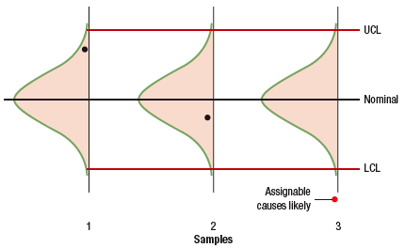
Control Charts
Control chart: A time-ordered diagram that is used to determine whether observed variations are abnormal.

Slide 29
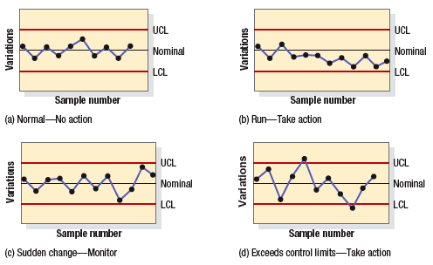
Control Chart Examples

Slide 30
Summary
Quality and Total Quality Management (TQM)
  Definition of quality and TQM
  Importance of quality and TQM
  Costs of quality
  Quality certifications and national awards
Six-sigma (6σ)
  Introduction to six-sigma
  Six-sigma methodology (DMAIC)
Statistical Process Control
  Capability Index (C_{pk})
  Control charts
Notes:
2

